Slide 1
Entity Linking and Discovery via Arborescence-based Supervised Clustering
Andrew McCallum, may 2022

Slide 2
Keypoints
Utilizes Cross Document Mention-mention relation
Extends to Entity Discovery (By Removing some ent from KB)
Unlike prev. paper which uses cross encoder , this uses Bi-Encoder
Improves 13 points on MedMentions dataset.
Improves Zero Shot Performance

Slide 3
Linking
For clustering , an affinity score is used between mentions and mention – entity pairs
Graph is built with nodes of mentions and entities.
Edges are inferred by the model.
From this graph, some edges are removed acc to the algorithm, and the disjoint graph is called the clusters.
Each cluster has at most one entity. All Mention in a cluster are linked to the entity in that cluster.

Slide 4
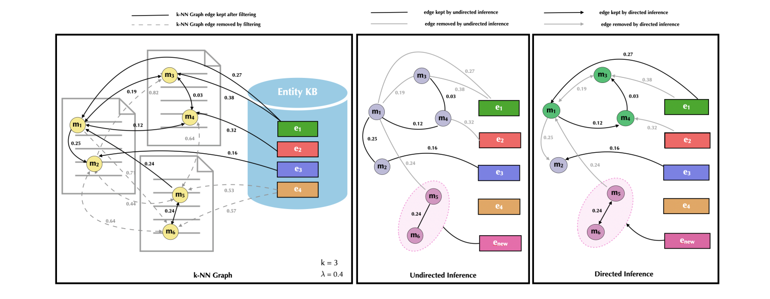
Example

Slide 5
Problem Statement
Each document 'd' of a corpus D contains a set of entity mention spans M(d). We assume they are pre-identified spans of mentions.
For each We want to perform :
Entity Linking
Zero Shot Linking
Linking + Discovery

Slide 6
Components of the Paper
Dissimilarity Function ( Edge weights)
Bi-encoder to train the edge weights
Constructing the graph
Building clusters.

Slide 7
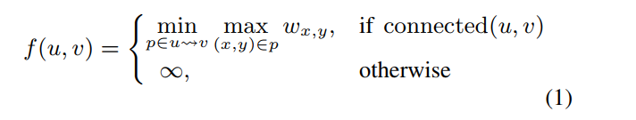
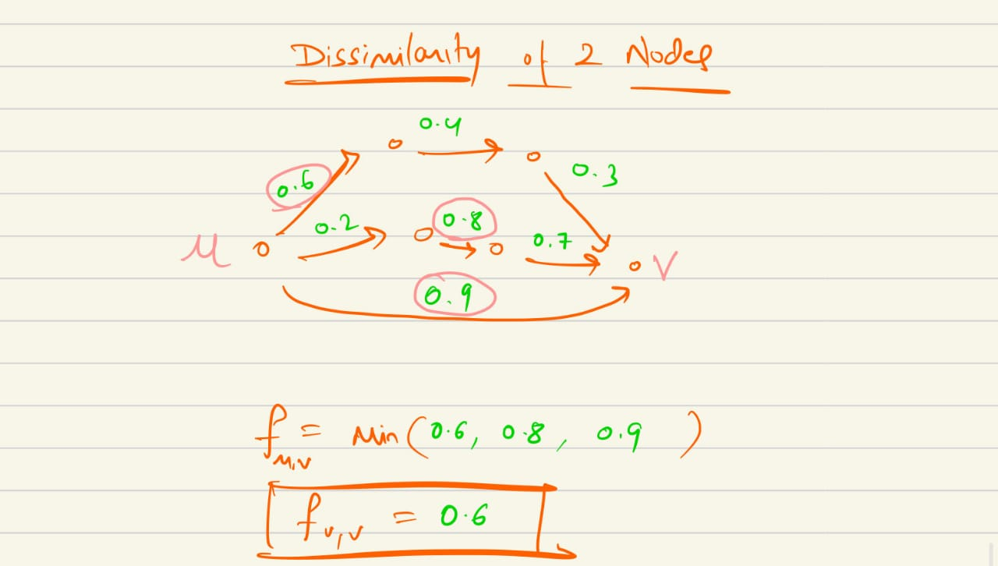
Dissimilarity Function (f)

Slide 8
Dissimilarity function (f)
This follows the property of bottleneck edges.
This eliminates low dissimilarity b/w nodes even when direct edge have high dissimilarity.
Inductive Bias : That not all pair of points in final cluster are nearby.

Slide 9
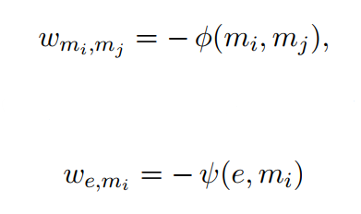
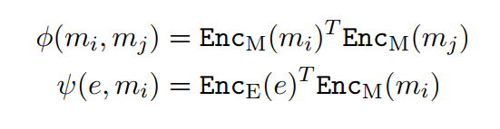
2. Bi-encoder to get edge weights (f)
2 affinity scores used i.e m-m affinity and m-e affinity.
Negative of this affinity values are the edge weights.
Separate encoders are used to get embedding of mentions and entities.
Affinity score is just inner product of the 2 mentions or m-e pair. (Scalar Value)

Slide 10
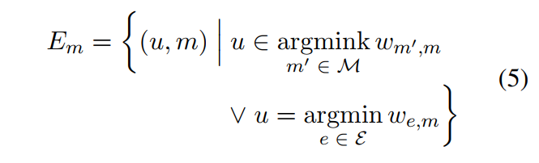
3. Constructing the graph
For each mention mi :
Add edges from its K-NN to mi
Add edge from its nearest entity to mi.
Removing direction adds a lot of noise to the graph.

Slide 11
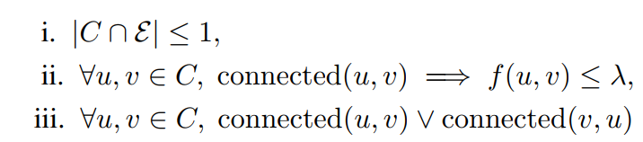
4. Forming Cluster
We want to partition the graph s.t each part contains at most one entity.
Constraints are :

Slide 12
How clustering is done
Remove all edges with w > threshold (lamda)
Arrange all edges in descending order of dissimilarity, check for the 3 constraints , if it violates , remove it.
Else, for current edge (u,v) if connected comp of u has one entity , temporarily drop edge and see if v can still be reached by another entity ?
If yes : Drop the edge , else keep it.
If any cluster has no entity , all mentions in it are now newly discovered and mapped to a new entity.

Slide 13
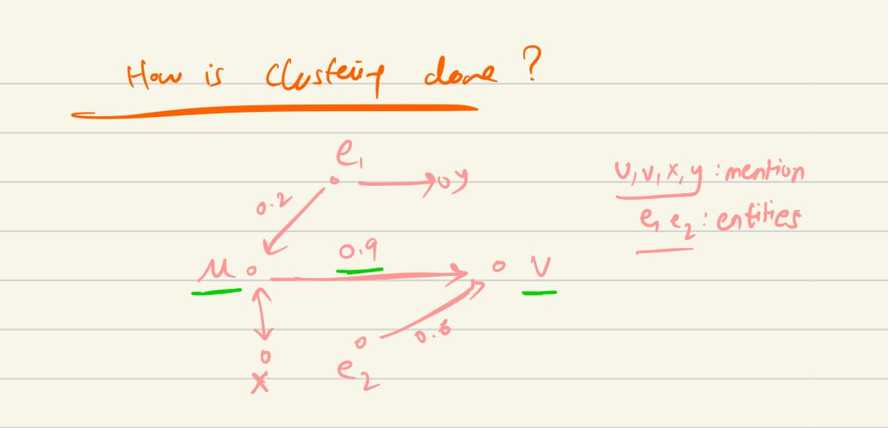
Clustering

Slide 14
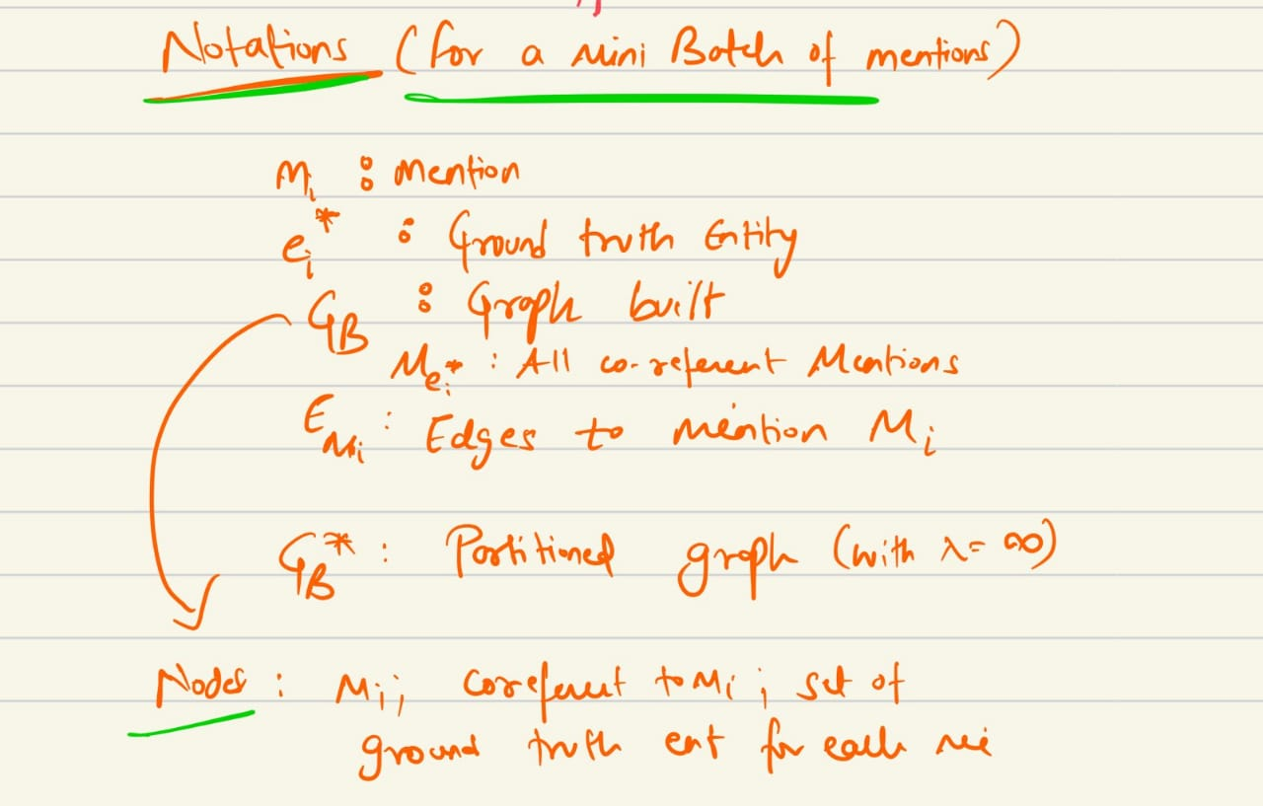
Training
Affinity Models are trained such that:
Clusters formed have all gold mentions and entity in it
At most one entity per cluster.

Slide 15
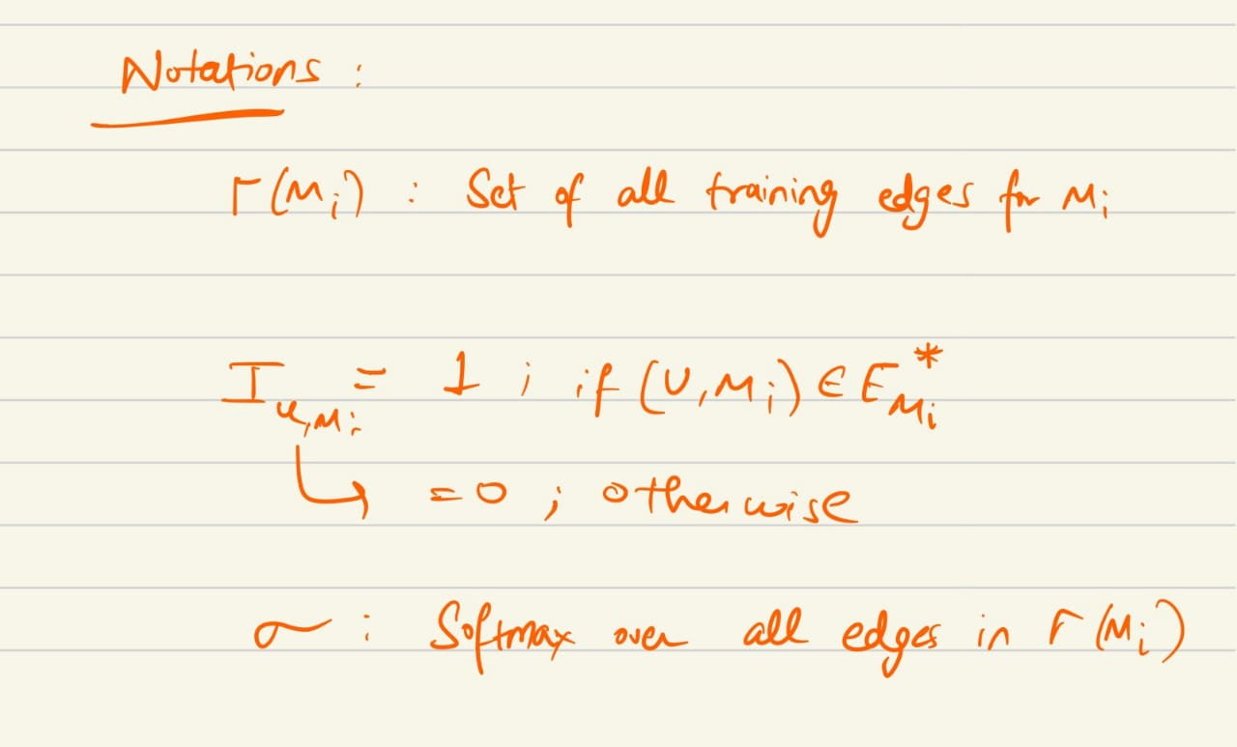
Adding Negative Edges
Negative sampling is used for each mi :
K/2 lowest weight incoming edges from entity set (except Gold)
K/2 lowest weight incoming edges form Mention set ( Except Gold )
Union of all these positive and negative edges forms the final edge set.

Slide 16
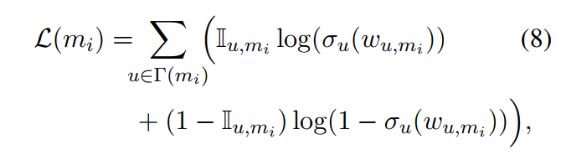
Partitioned graph
G(b)* is the disjoint graph, each CC rooted at entity node (MSA).
The edges inferred by model for any mention mi are used to optimize the encoder model.
Loss function (with respect to each mention mi):

Slide 17
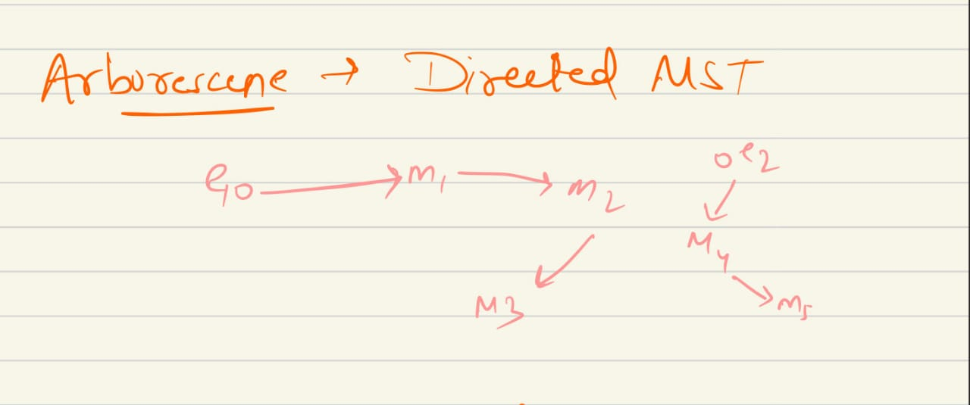
Arborescene

Slide 18
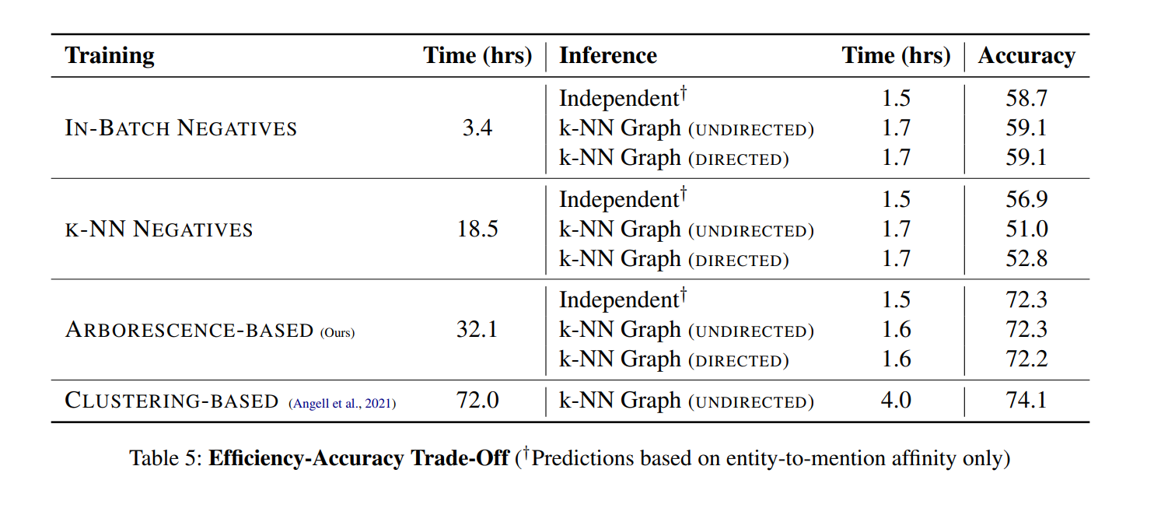
Results (With Prev Paper )

Slide 19
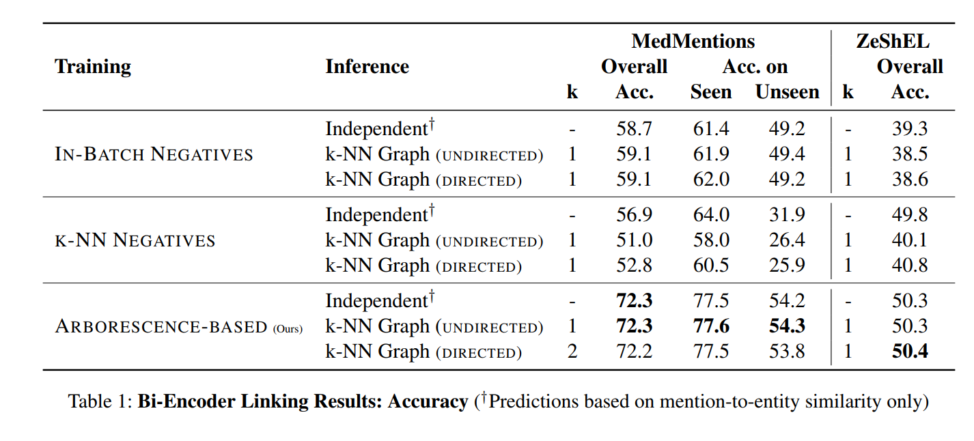
Results

Slide 20
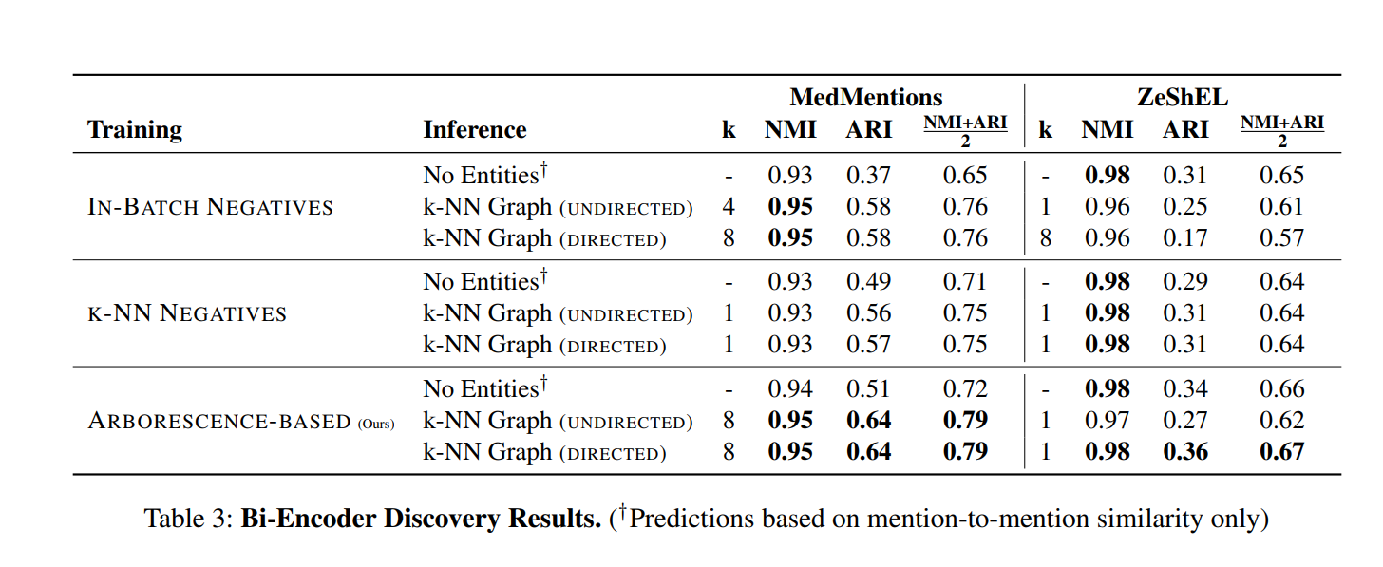
Result – Ent Discovery

